Slide 1


Capstone Project 3
Mobile Price Range Prediction
( Classification Project )
By: Prabhat Rajput

Slide 2
Objective
An accurate classification of mobile phones into various price ranges based on their features and specs is the goal of a mobile price ML model. By automating the classification process and offering pricing insights, this model seeks to aid consumers in making informed purchase decisions, ultimately improving the shopping experience in the mobile phone market.

Slide 3
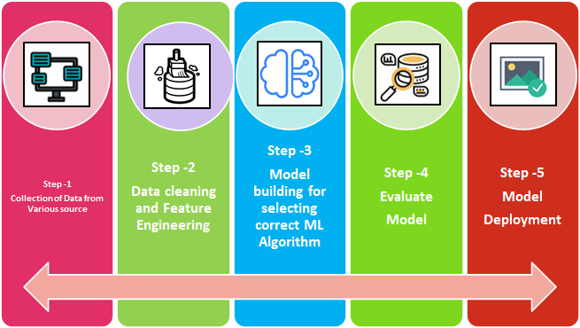
Steps included in the project

Slide 4
Variable Description of dataset
battery_power- Battery Capacity in MAh
blue- Has Bluetooth or not
clock_speed- Speed at which microprocessor executes instructions
dual_sim- Has dual sim support or not
fc- Front camera megapixels
four_g- Has 4g or not
int_memory- Internal memory capacity
m_dep- mobile depth in cm
mobile_wt- Weight of mobile phone
n_cores- Number of cores in processor
pc- Primary camera megapixels
px_height- Pixels resolution height
px_width- Pixel resolution width
ram- Random Access Memory in MB
sc_h- Screen Height
sc_w- Screen Width
talk_time- Longest that a single battery can last over a call
three_g- Has 3g or not
touch_screen- phone have touchscreen or keypad
wifi- Has wifi or not
price_range- This is the target variable with a value of 0 (low cost), 1 (medium cost), 2 (high cost), and 3 (very high cost)

Slide 5
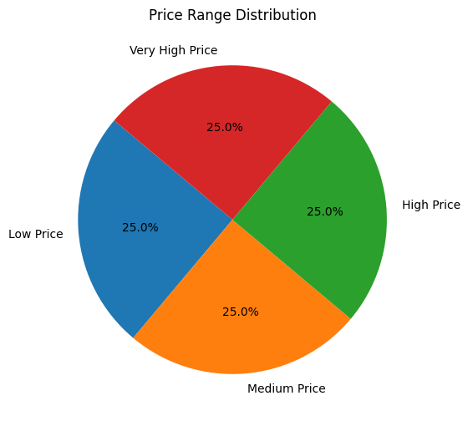
Mobile distribution with price
Insights:
Here we can see, in this chart that all the price segment are equally popular with 25% each market share.
So there is no difference in distribution with its price segment.

Slide 6
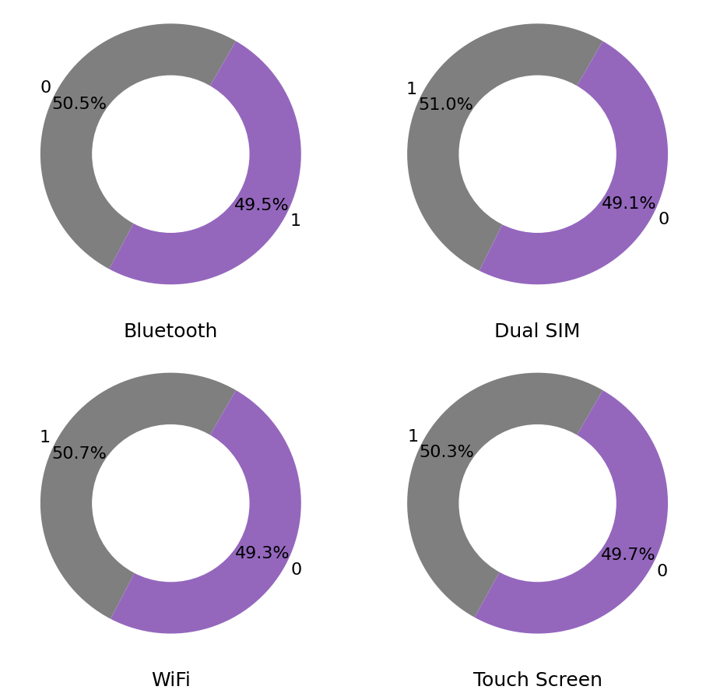
A pie chart for some variable
Insight:
In this chart we get the share percentage of all the columns in the dataset.
Almost 50% of our mobiles have Bluetooth, dual SIM, Wi-Fi and touch screen.

Slide 7
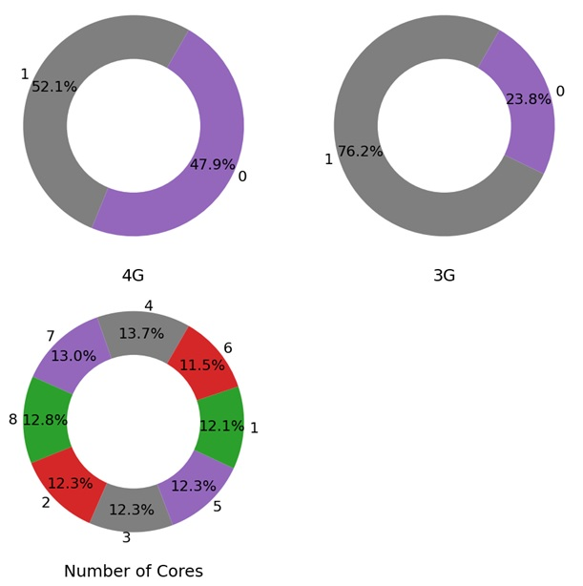
Some another variable of the dataset
Insights:
In this chart we can see that
About 48% mobile are 4G, and about 76% mobiles are 3G in the dataset.
We have 8 type of CPU in the dataset which have almost equal share in the mobiles.

Slide 8
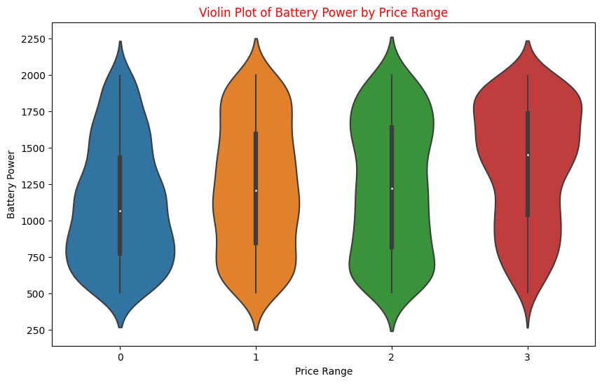
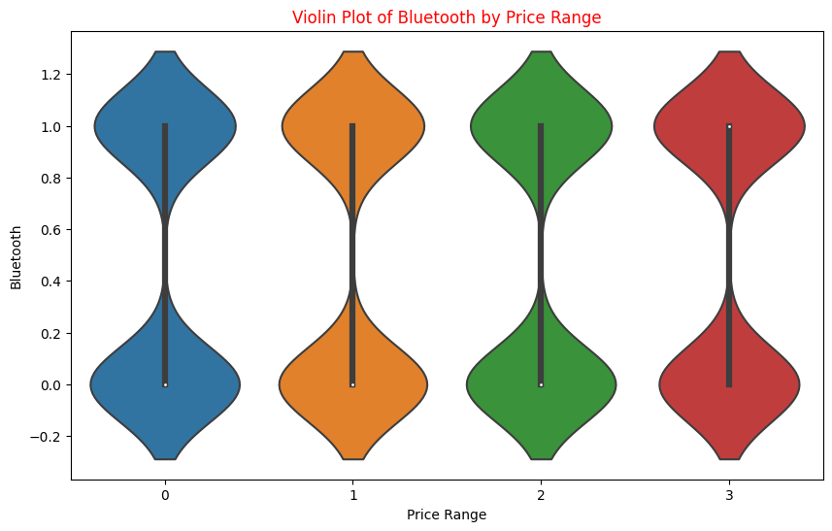
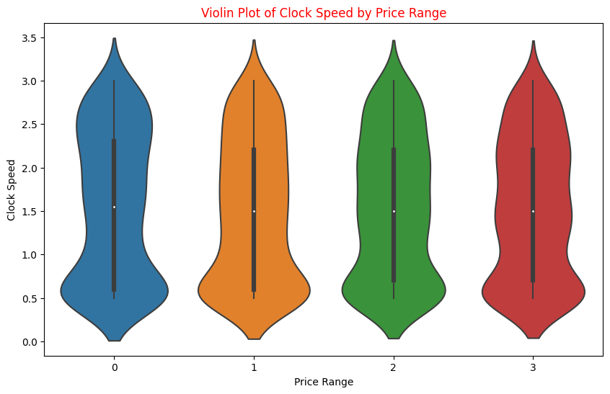
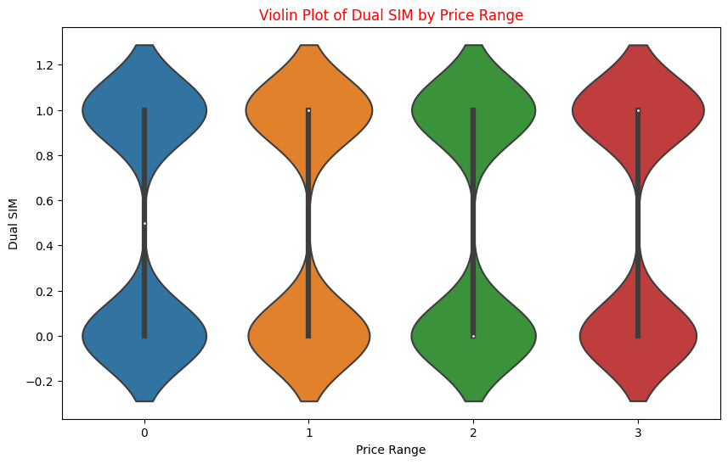
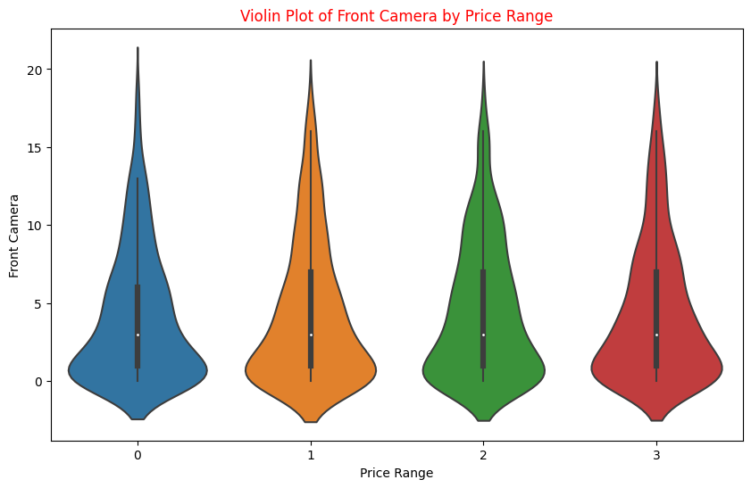
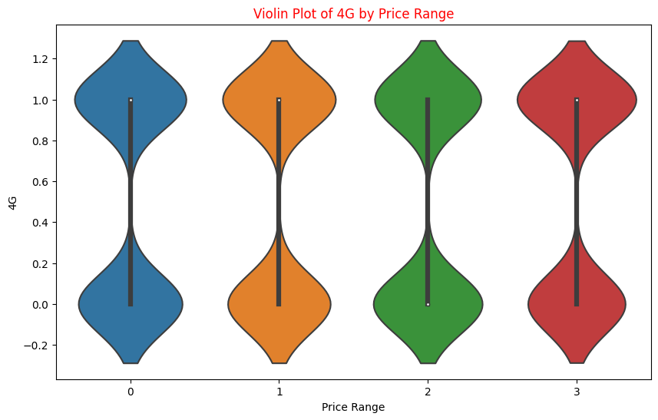
Relationship between independent variable to dependent variable:
Some features have direct relation like Battery power, Clock_speed etc. with target feature and some are not like Blue, sim ports etc.

Slide 9
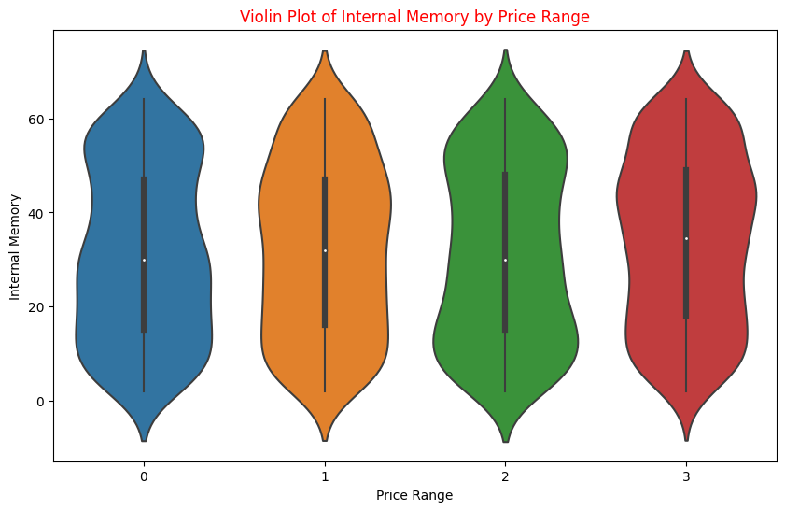
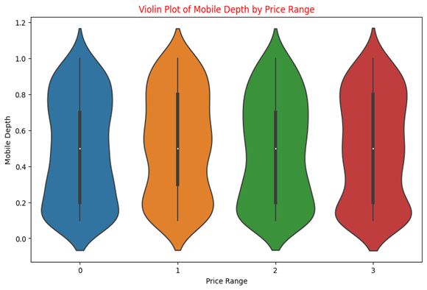
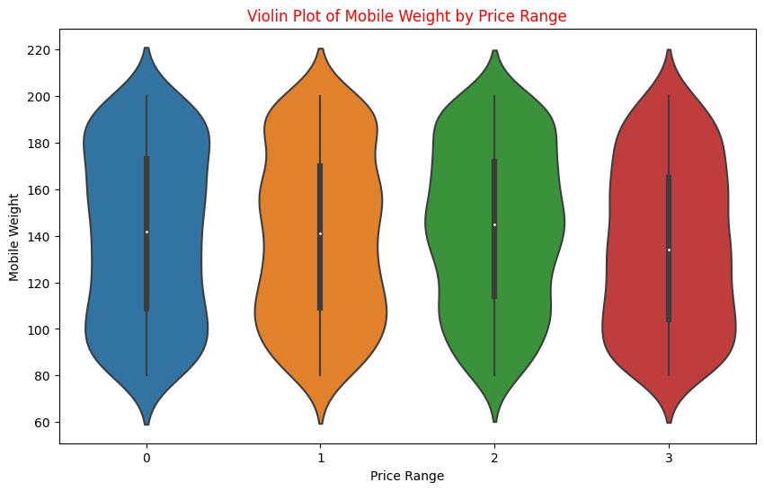
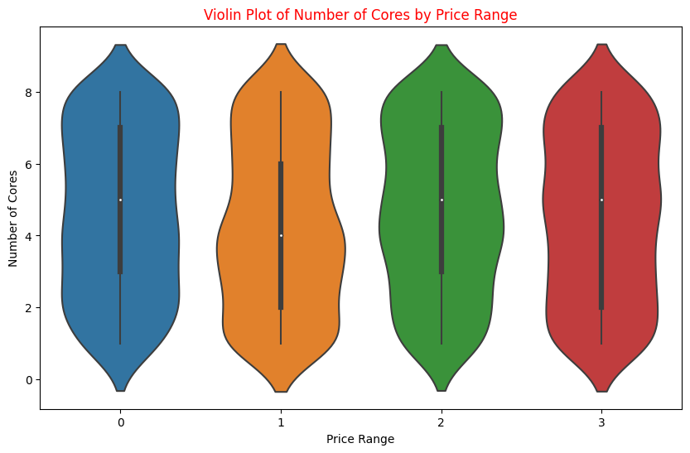
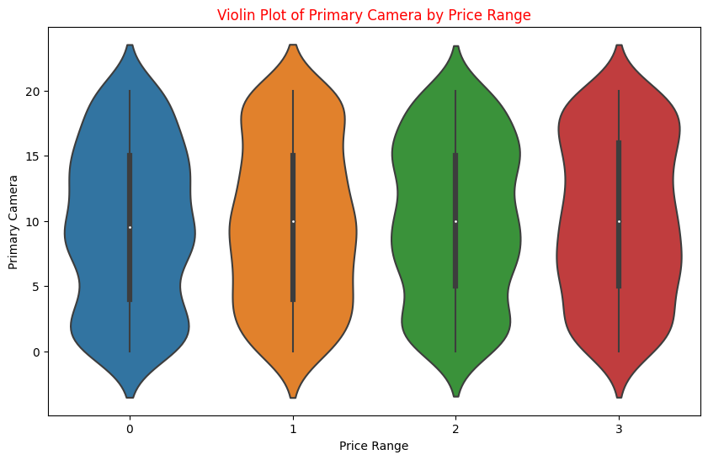
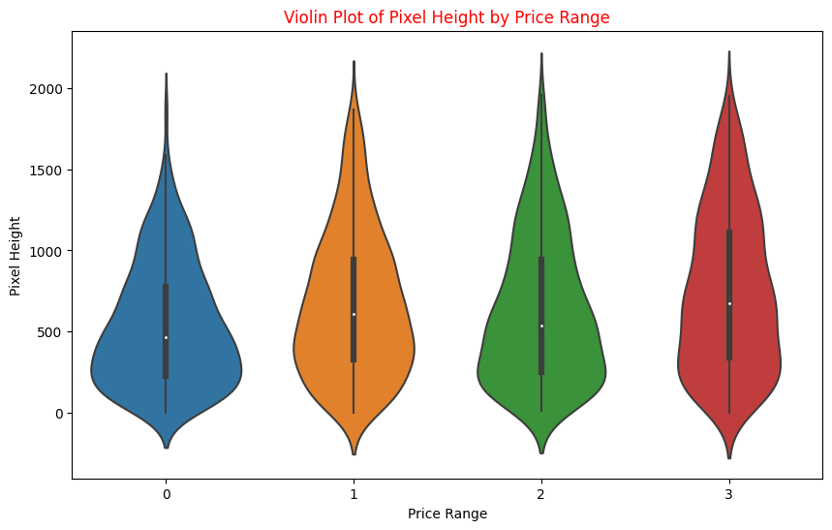
In this page we can see the direct connection of internal memory, mobile depth, mobile weight, CPU cores, display pixel with Price range.

Slide 10
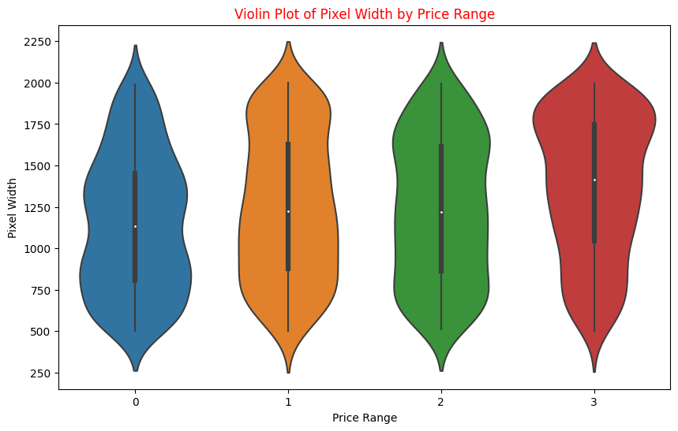
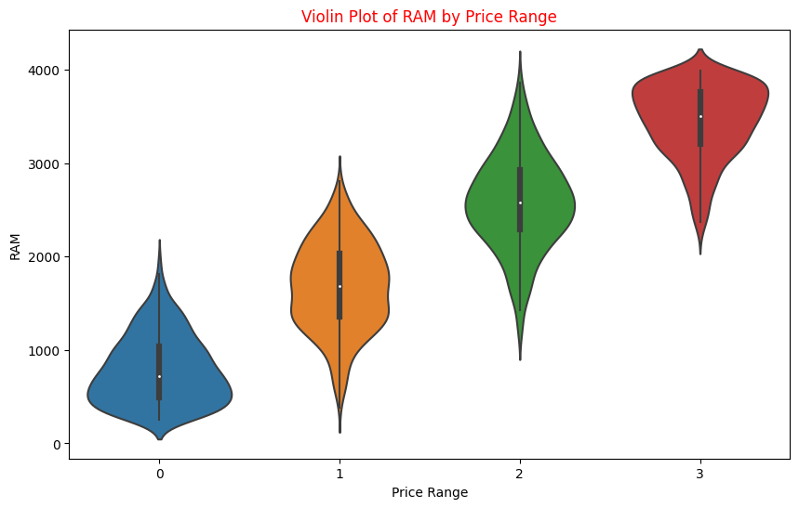
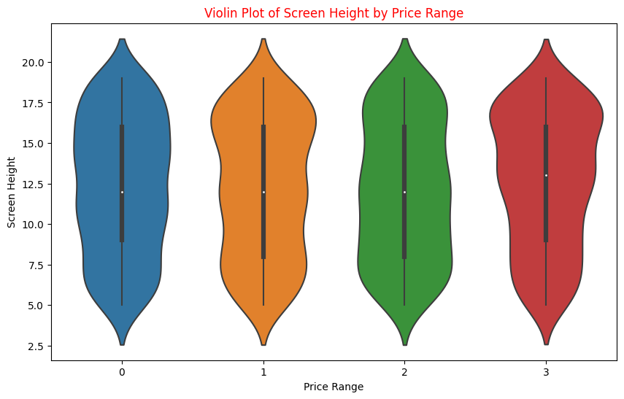
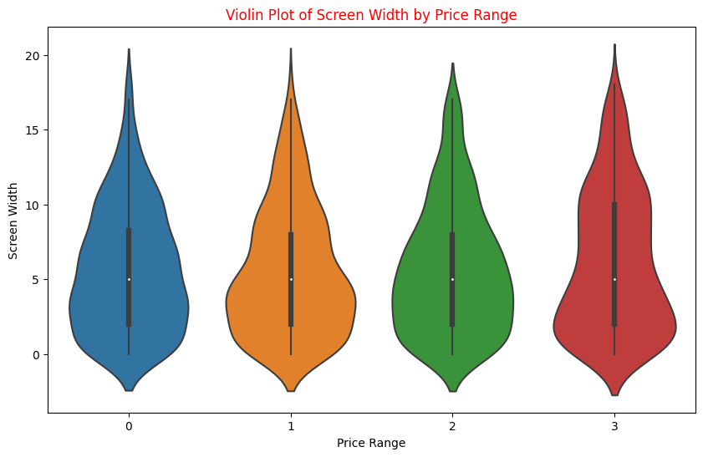
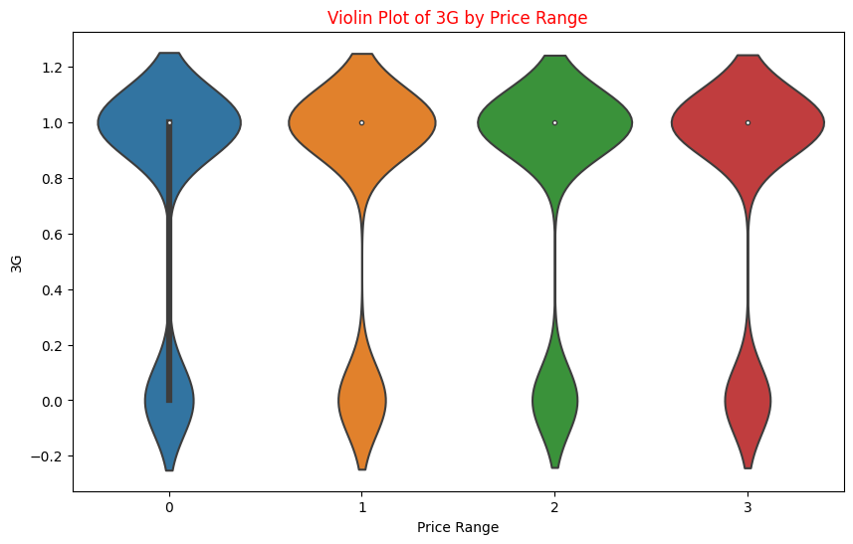

Slide 11
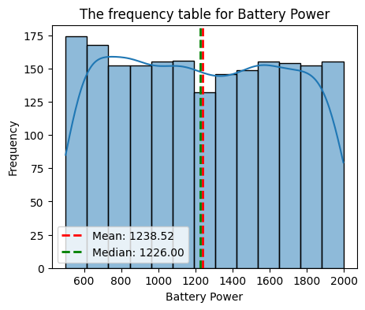
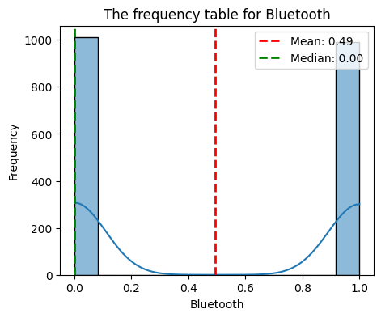
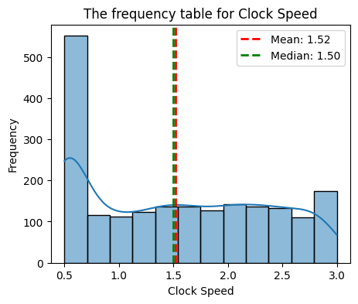
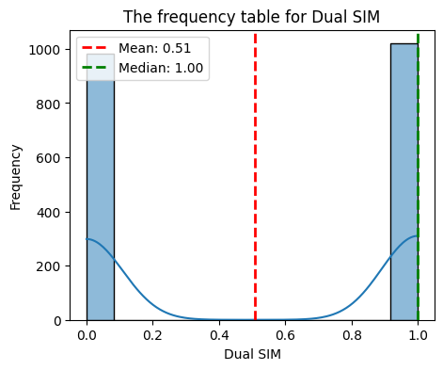
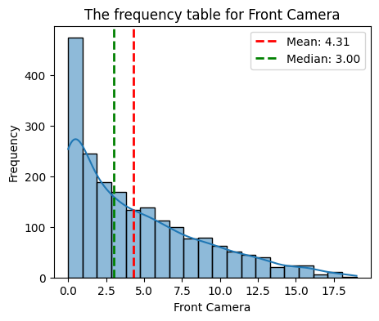
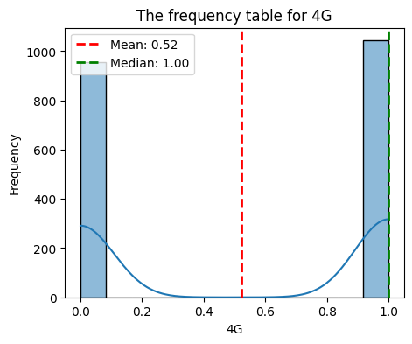
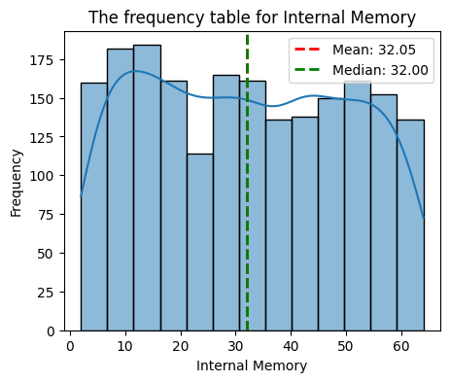
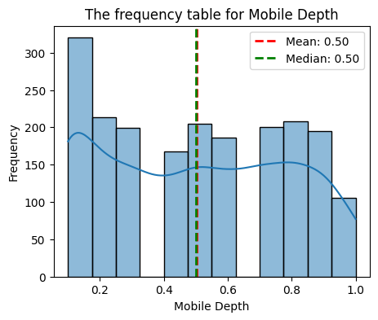
Charts to show the mean and median value of all numeric columns:
Median is the value in the middle of the category, the half quartile or middle value by which half values are up and half values are down.
Mean is the average of set of values of a category

Slide 12
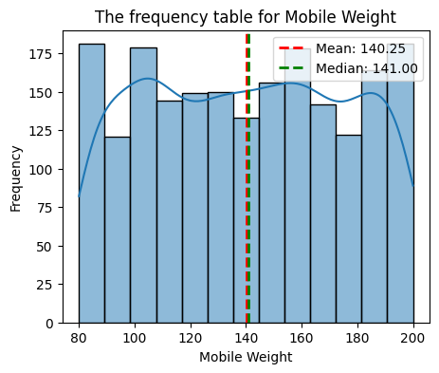
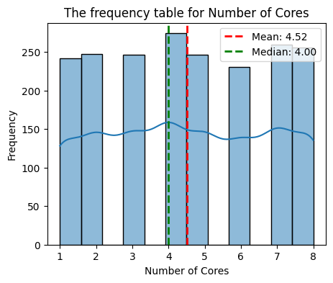
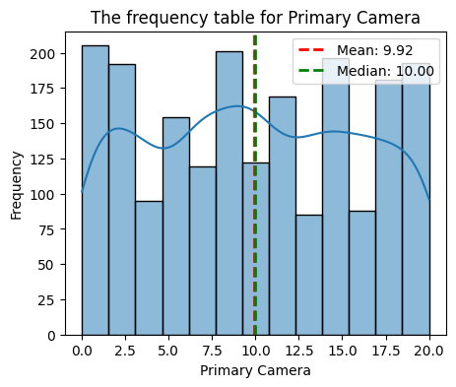
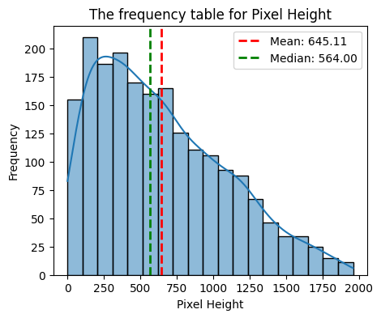
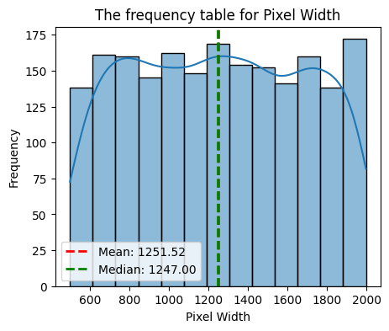
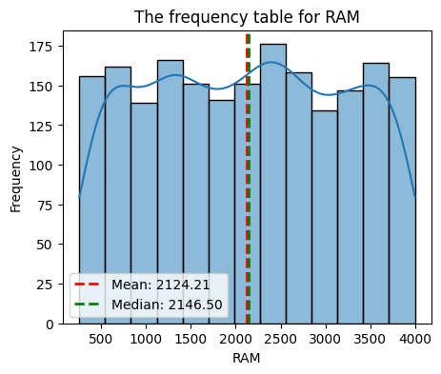
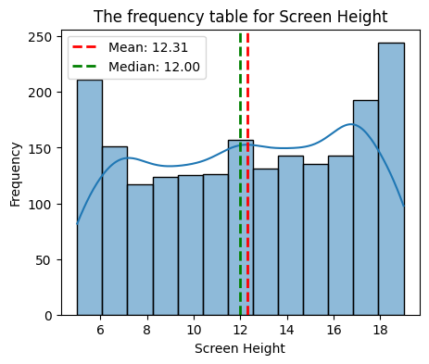
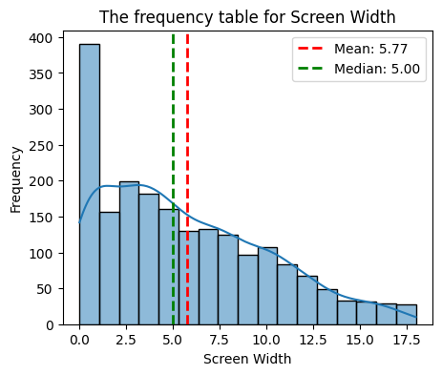

Slide 13
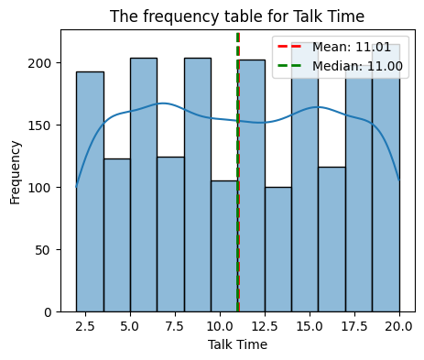
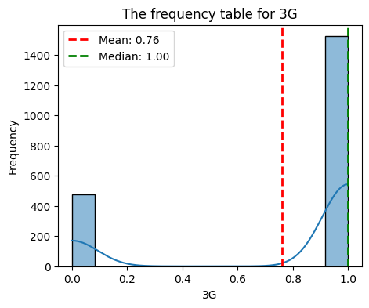
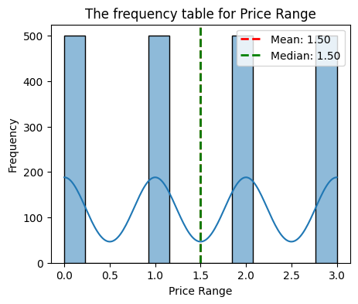
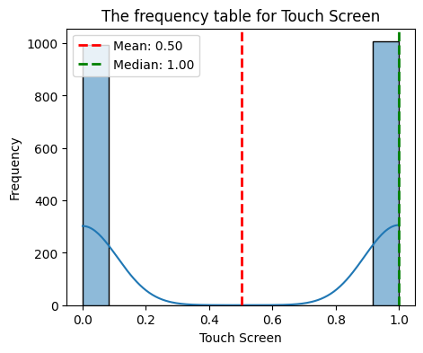
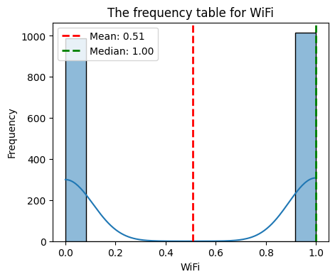

Slide 14
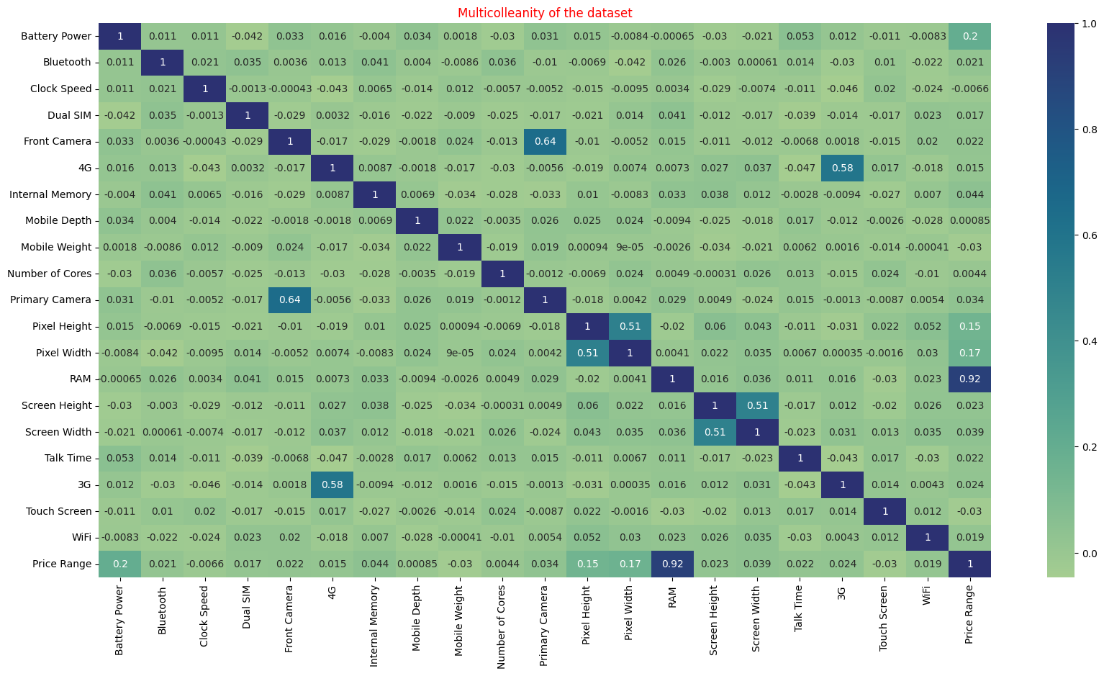
Multiclonality of the Dataset
Variable “pc” and “fc” is moderately correlated.
Variable “three_g” and “four_g” is moderately correlated
Variable “ram” and “price_rane” has the highest correlation.
“Px_width” and “px_height” has also very moderately correlated.

Slide 15
FEATURE Engineering and DATA Preprocessing
Feature engineering can help data scientists by accelerating the time it takes to extract variables from data, allowing for the extraction of more variables. We use to do this to reduce multicollinearity among the variables.
#To avoid multiculanity we drop some function as well as concatenate some function.
# Calculate the total camera pixels by adding Front Camera and Primary Camera
df1['Camera_pixels'] = df1['Front Camera'] + df1['Primary Camera']
# Calculate the total pixels by multiplying Pixel_Height and Pixel Width
df1['Screen Pixels'] = df1['Pixel Height'] * df1['Pixel Width']
# Calculate the total screen size by multiplying Screen Height and Screen Width
df1['Screen Size'] = df1['Screen Height'] * df1['Screen Width']
# Drop some original function.
df1.drop(columns=['Front Camera', 'Primary Camera', 'Pixel Height', 'Pixel Width', 'Screen Height', 'Screen Width'], axis=1, inplace=True)
# Feature creation: ram & price_range
df1['ram_price'] = df1['RAM'].astype(str) + '_' + df1['Price Range'].astype(str)
df1.drop('RAM', axis=1, inplace = True) # drop the original column

Slide 16
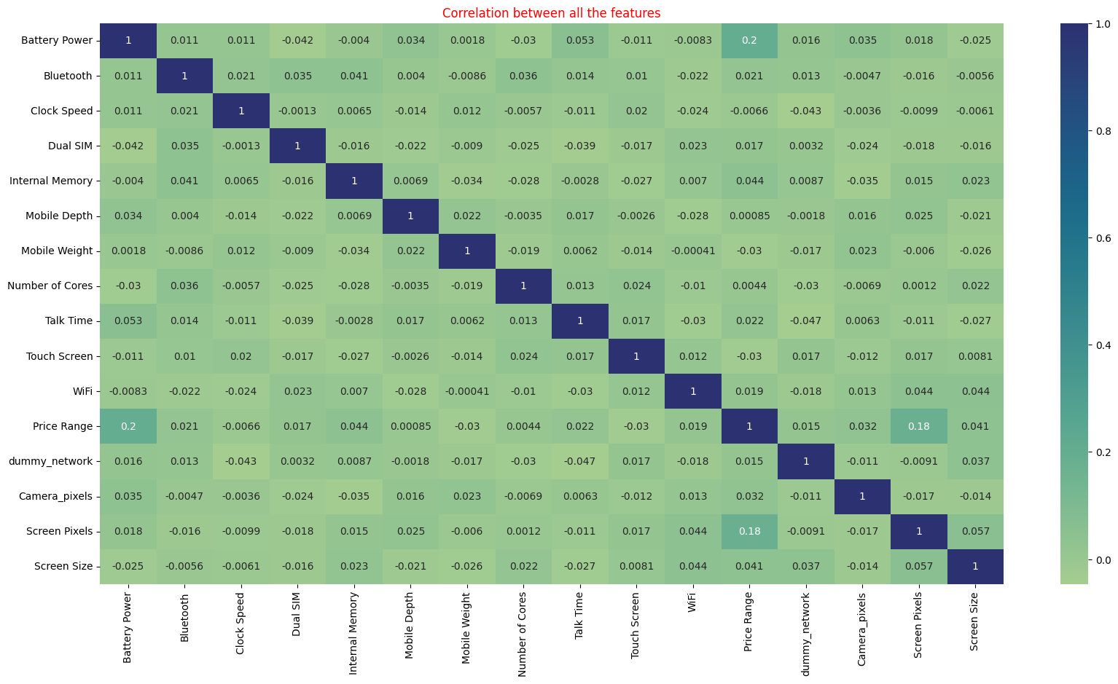
Check the Correlation again with new variables
From Changing some variable in dataset, now
we resolve all multicolleanity problem with the dataset.

Slide 17
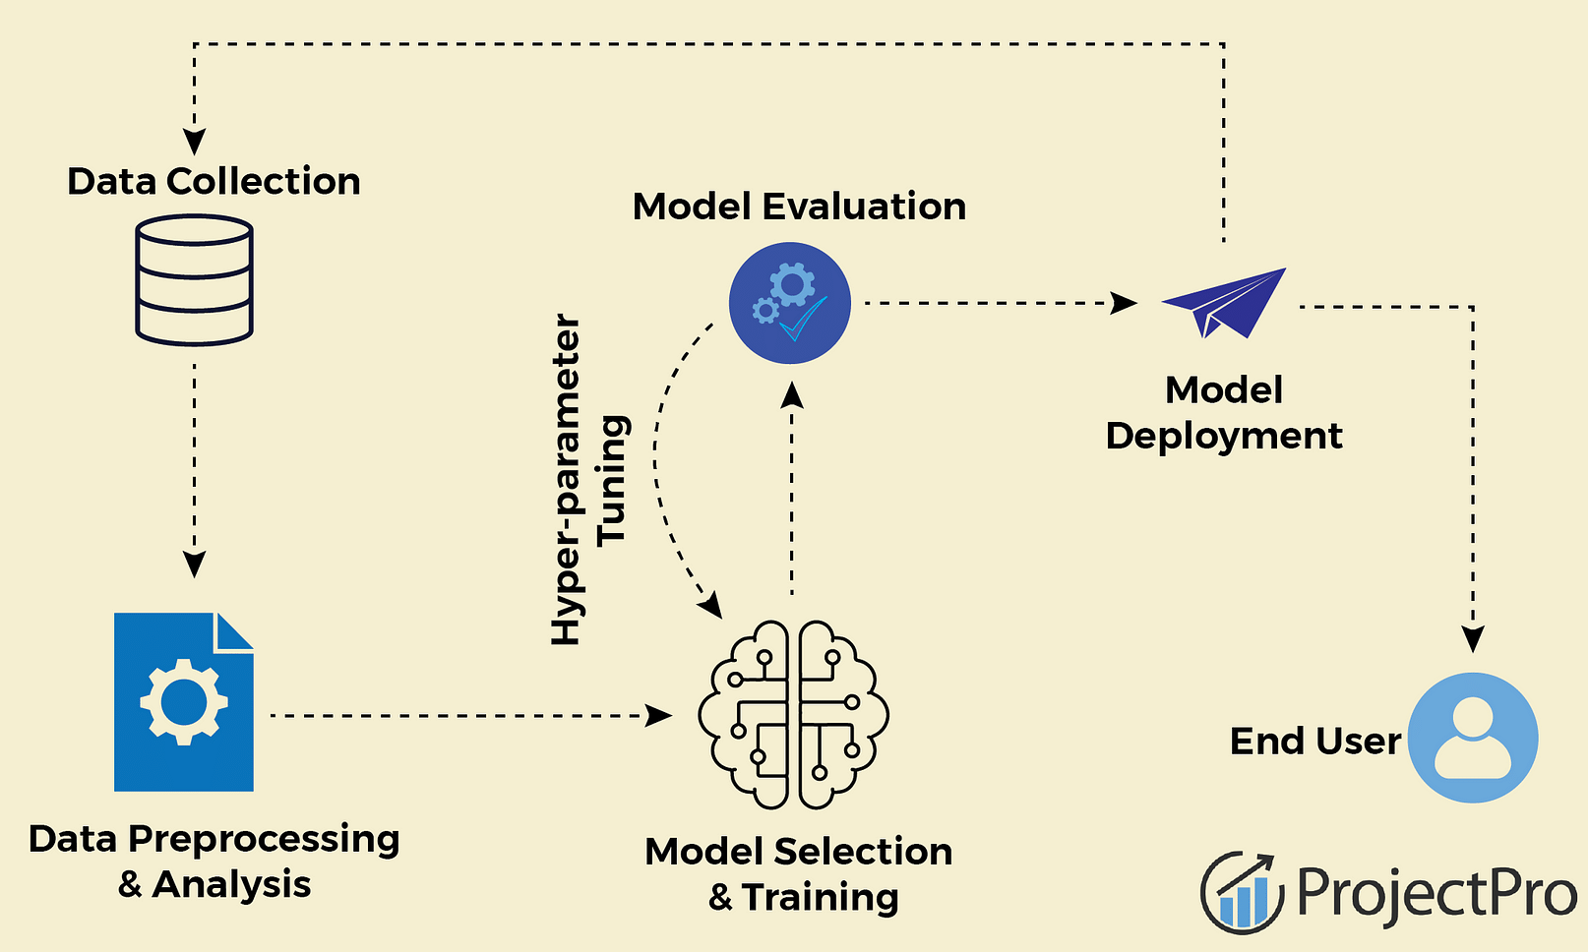
Model Fitting
Implementing testing and training data into various algorithms is essentially what model fitting entails. Here, we employ 5 algorithms to determine the degree of correctness of the output.
Logistic Regression
K-nearest neighbors
Tree Classifier
Random Forest Classifier
Support Vector Machine

Slide 18
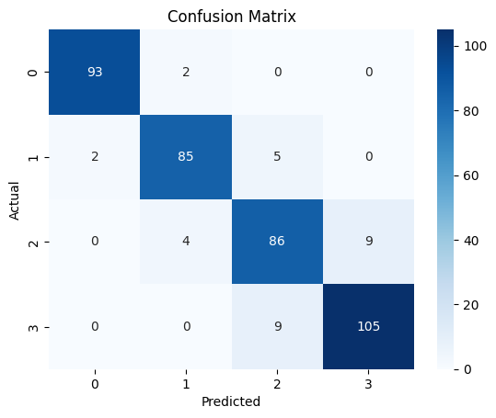
Logistic Regression
Report
Accuracy: 0.955
Precision:0.9226851648351648
Recall: 0.9225
F1 Score: 0.9225808001757421
Confusion Matrix:
[[ 93 2 0 0]
[ 2 85 5 0]
[ 0 4 86 9]
[ 0 0 9 105]]

Slide 19
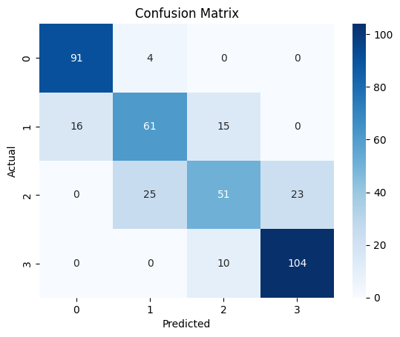
Decision Tree Classification
Report
Accuracy: 0.789375
Precision: 0.757346223284 Recall: 0.7675
F1 Score: 0.7583932192822583 Confusion Matrix:
[[ 91 4 0 0]
[ 16 61 15 0]
[ 0 25 51 23]
[ 0 0 10 104]]

Slide 20
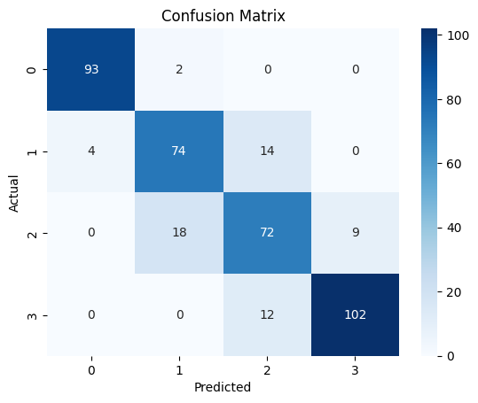
Random Forest Classifier
Report:
Accuracy: 0.97125
Precision:0.85249864194
Recall: 0.8525
F1 Score: 0.85240258327 Confusion Matrix:
[[ 93 2 0 0]
[ 4 74 14 0]
[ 0 18 72 9]
[ 0 0 12 102]]

Slide 21
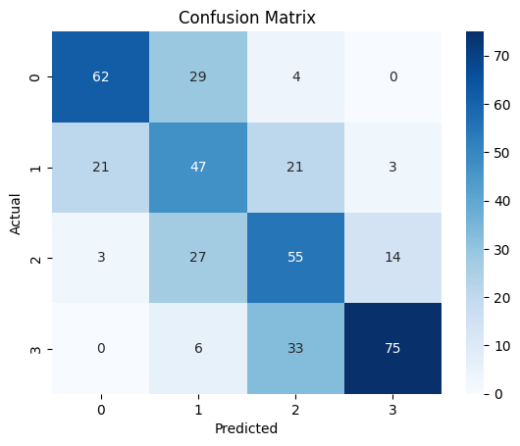
K-Nearest Neighbors (KNN)
Report:
Accuracy: 1.0
Precision: 0.6231968004508
Recall: 0.5975
F1 Score: 0.6062134545405833 Confusion Matrix:
[[62 29 4 0]
[21 47 21 3]
[ 3 27 55 14]
[ 0 6 33 75]]

Slide 22

Support Vector Machine (SVM)
Report
Accuracy: 0.955
Precision: 0.9197820087034242
Recall: 0.92
F1 Score: 0.9198678891014913 Confusion Matrix:
[[ 94 1 0 0]
[ 2 84 6 0]
[ 0 8 84 7]
[ 0 0 8 106]]

Slide 23
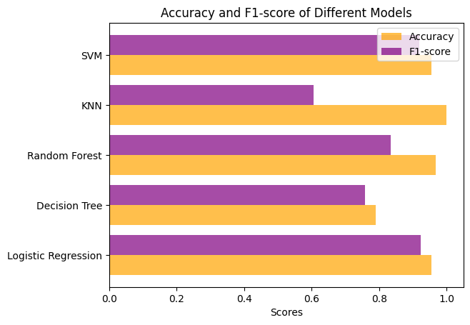
Accuracy and F1-score Chart for different model
Report:
In this Chart we define Accuracy and F1-Score for all model where as accuracy is almost above 90% in all the model where as F1- score also above 85% in all models.

Slide 24
Business Objective
The purpose of predicting mobile price ranges in a business context can vary, depending on the unique circumstances and objectives of the enterprise. Below are several potential business aims when it comes to forecasting mobile device prices:
Optimizing Pricing Strategies: The business aims to enhance its pricing tactics through precise forecasts of mobile device price ranges. This enables the business to determine the ideal pricing structures for various mobile devices, accounting for factors such as production expenses, market competition, and customer preferences.
Enhancing Sales Projections: Precise predictions of mobile price ranges play a pivotal role in sales and revenue forecasting. As pricing significantly influences customer buying decisions, the business can anticipate sales trends better. This empowers the business to efficiently manage inventory, production, and marketing endeavors.
Tailoring Market Segmentation: Mobile price range prediction facilitates market segmentation, enabling the business to categorize and target distinct customer groups based on their price range preferences. For instance, the business can tailor marketing approaches for cost-conscious customers seeking budget-friendly mobile devices versus premium customers willing to invest in high-end options.

Slide 25
Some more point related to Business context:
4. Conducting Competitive Assessment: Accurate mobile price prediction support competitive analysis by allowing the business to assess its pricing strategy against that of rivals. This provides insights into the business's pricing positioning within the market and identifies opportunities for adjustments to gain a competitive advantage.
5. Personalized Customer Engagement: Mobile price range forecasts can be leveraged for personalized customer interactions, customizing pricing and promotional offers according to individual customers' predicted price range inclinations. This fosters improved customer satisfaction, loyalty, and retention by aligning pricing with customer expectations and financial capabilities.

Slide 26
Conclusion:
In summary, tackling the mobile price range prediction challenge represents a classic machine learning classification task. The primary objective is to forecast the price category of mobile devices based on specific attributes. In this project, we undertook the training and evaluation of various machine learning classification models, utilizing a dataset that included mobile device features and their corresponding price ranges.
Following an in-depth analysis of the dataset, feature engineering efforts, and the creation of distinct training and testing subsets, we proceeded to train and assess multiple classification models. These encompassed Logistic Regression, Decision Tree, Random Forest, K-Nearest Neighbors (KNN), and Support Vector Machine (SVM). We gauged their performance through key metrics such as accuracy, precision, recall, and F1-score.

Slide 27


